Slide 1
Midterm Report
NYCU MSE
309613006 陳博翔
310613021 陳思葳
310613037 黃思潔
2022 / 04 / 19

Slide 2
Outline
With Standardization vs Without Standardization
Broad Network vs Deep Network
Training Set ( Low V0 , Low θ )
Training Set ( Even V0 ) , Testing Set ( Odd V0 )

Slide 3
ML Setting
Input
Layers
Hidden Layers
Output
Layers
Machine Learning Setting
Data | • 10000 Dataset (1 < V0 < 100 , 1° < θ < 89°) 80% ( Train ) 20% ( Test )
Model | • ANN • Hidden layers : 5 • Nodes : 10 / layer • Activation Functions : relu • Optimizer : adam • Epoch : 500 • Batch Size : 500
Evaluation | • MSE ( Mean Squared Error) • 5 - fold Cross-Validation
V0
H
θ
R

Slide 4
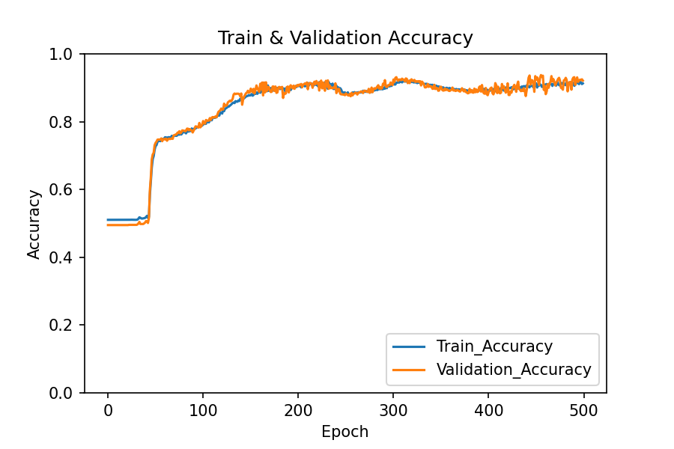
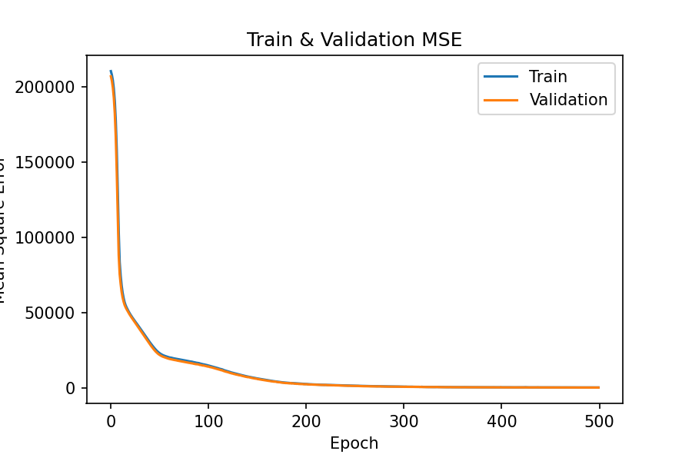
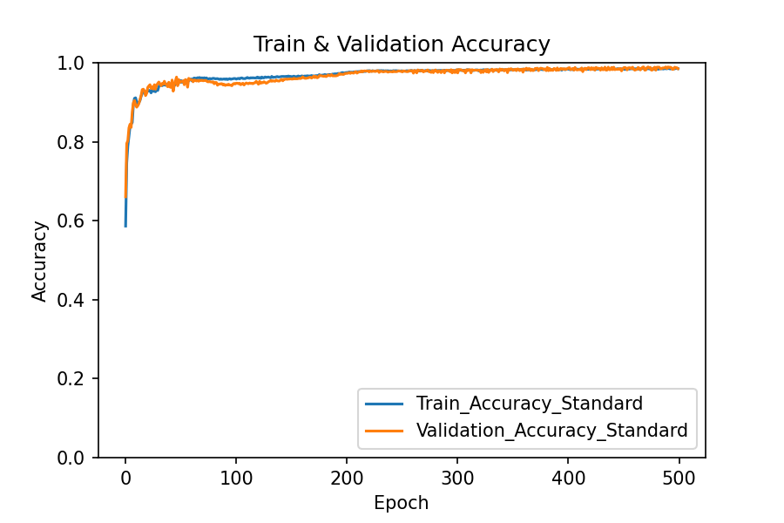
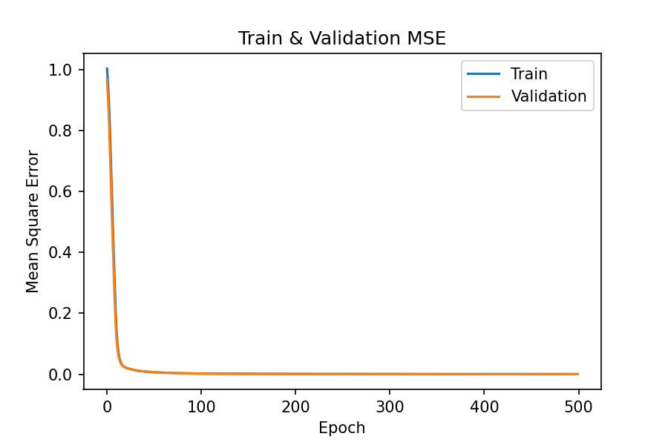
With Standardization vs Without Standardization
Without
Standardization
Accuracy : 94.75%
Loss : 406.7997
With
Standardization
Accuracy : 98.75%
Loss : 0.000592
Notes:
收斂速度

Slide 5
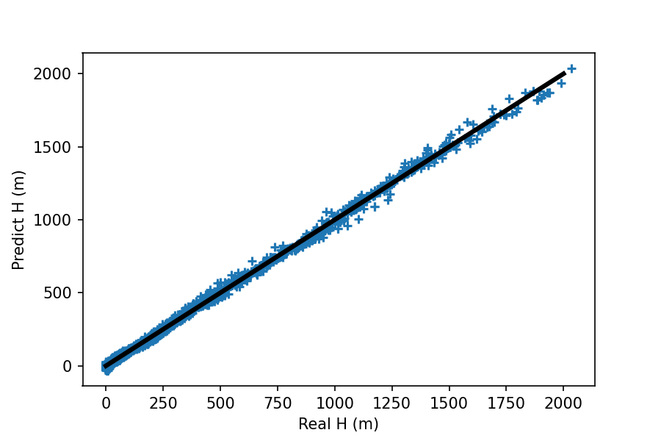
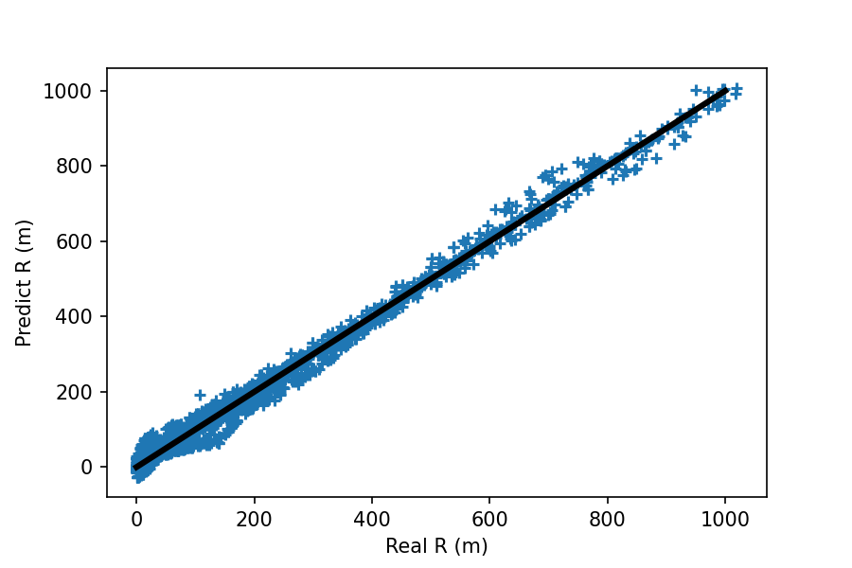
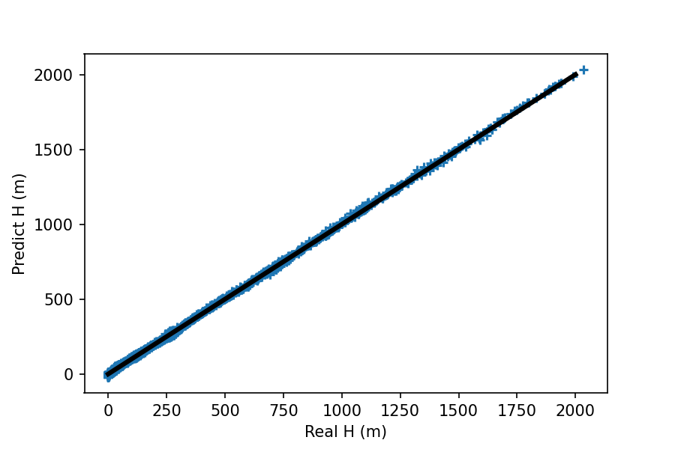
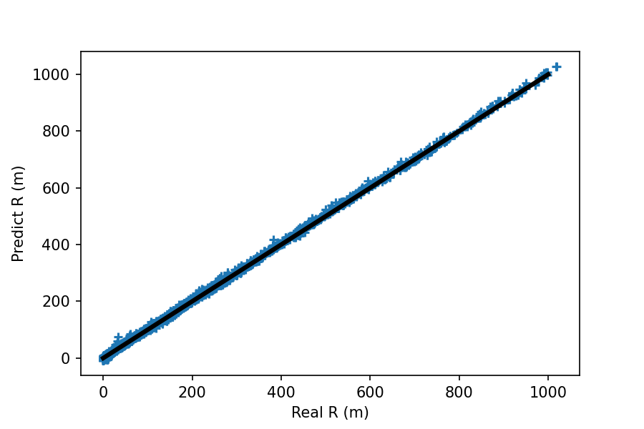
With Standardization vs Without Standardization
Without
Standardization
r = 0.99896
r = 0.99642
With
Standardization
r = 0.99981
r = 0.99972
Pearson correlation coefficient (r)

Slide 6
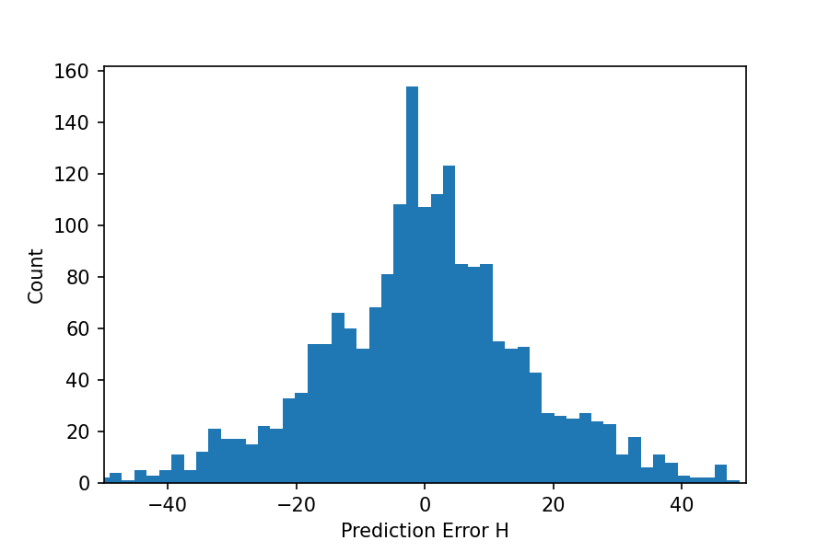
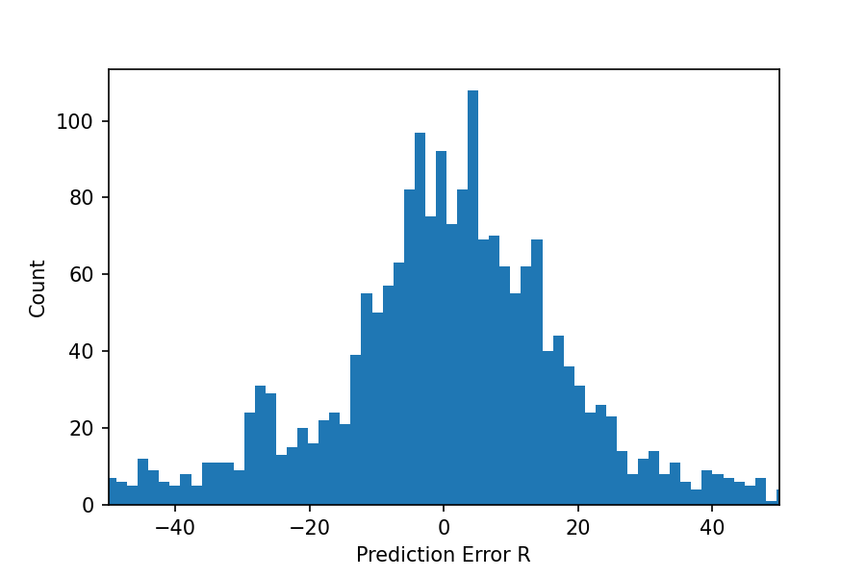
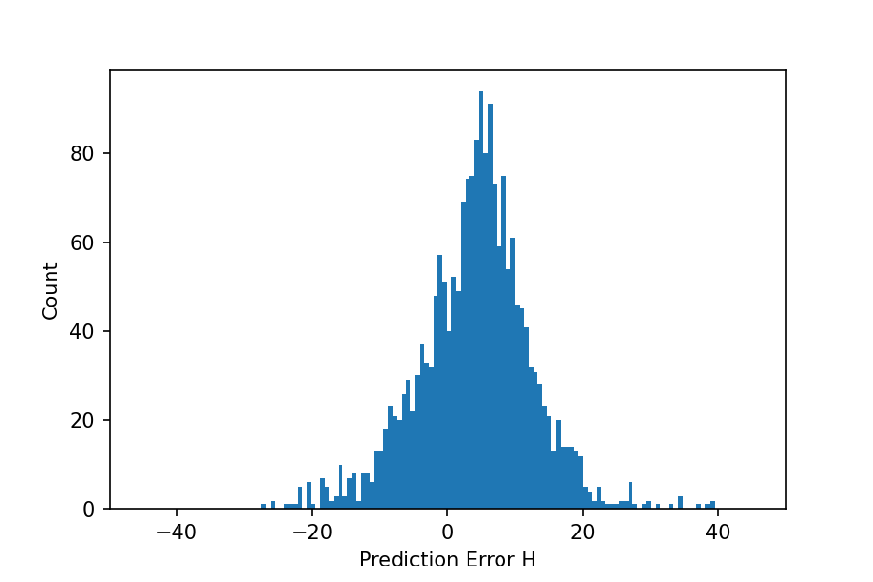
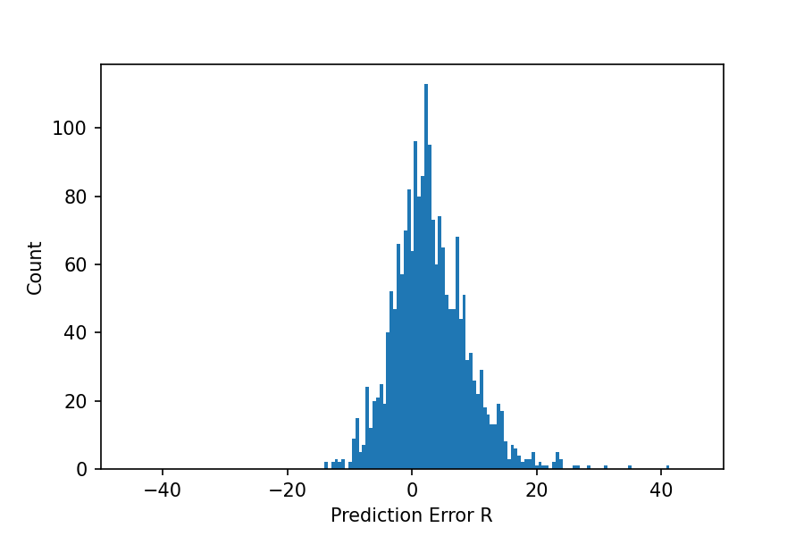
With Standardization vs Without Standardization
Error = Predict [value] - Real [value]
Without
Standardization
With
Standardization

Slide 7
ML Setting
Machine Learning Setting
Data | • 10000 Dataset (1 < V0 < 100, 1° < θ < 89°) ➔ (1 < V0 < 10000 , 1° < θ < 89°) 80% ( Train ) 20% ( Test )
Model | • ANN • Hidden layers : 5 • Nodes : 10 / layer • Activation Functions : relu • Optimizer : adam • Epoch : 500 • Batch Size : 500
Evaluation | • MSE ( Mean Squared Error) • 5 - fold Cross-Validation

Slide 8
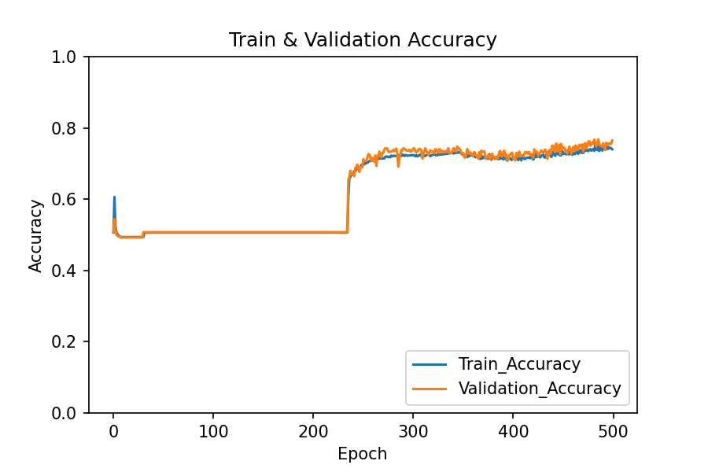
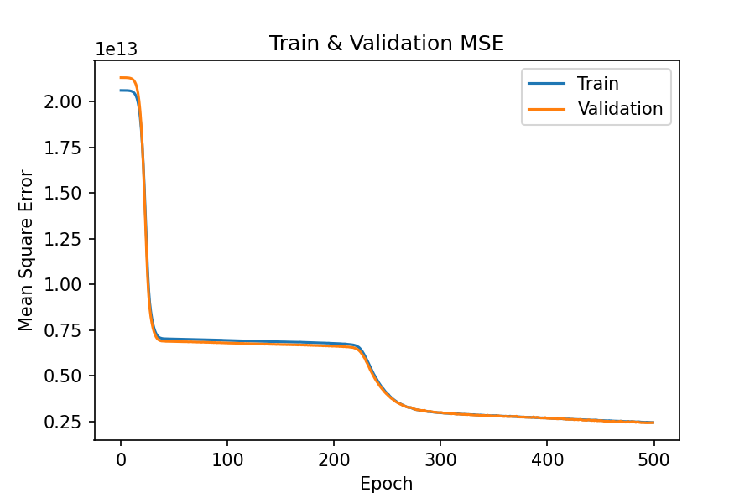
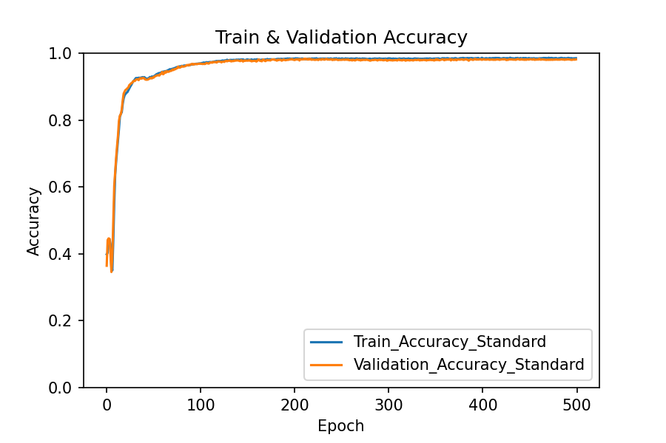
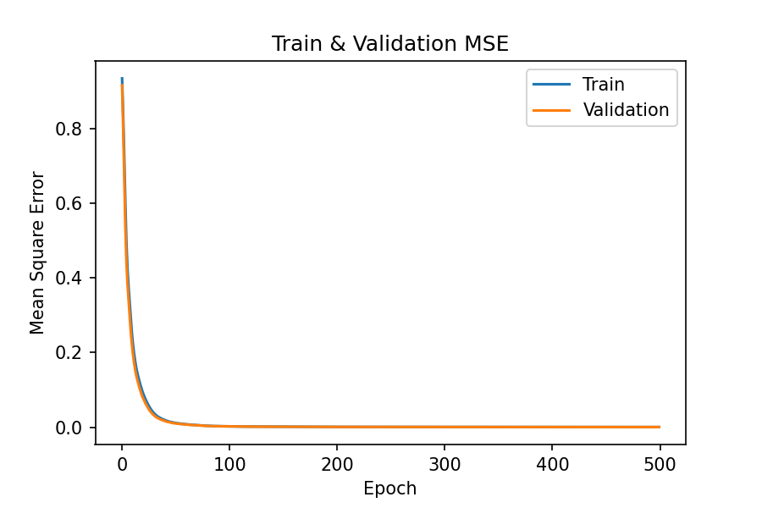
With Standardization vs Without Standardization
Without
Standardization
Accuracy : 75.70%
Loss : 2429060000000
With
Standardization
Accuracy : 97.85%
Loss : 0.0004065048
Notes:
收斂速度

Slide 9
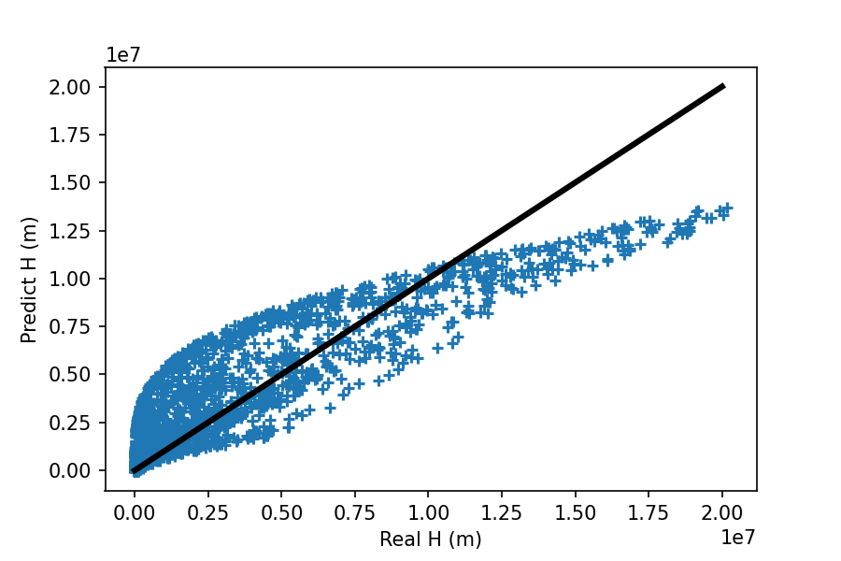
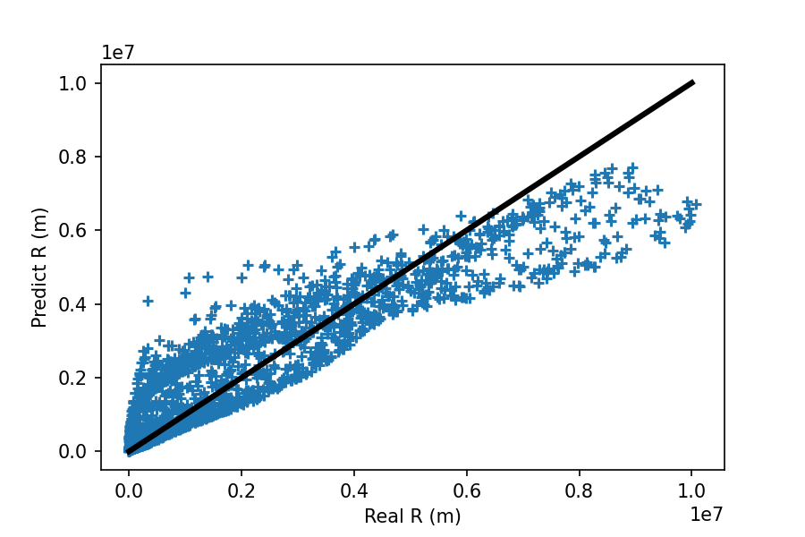
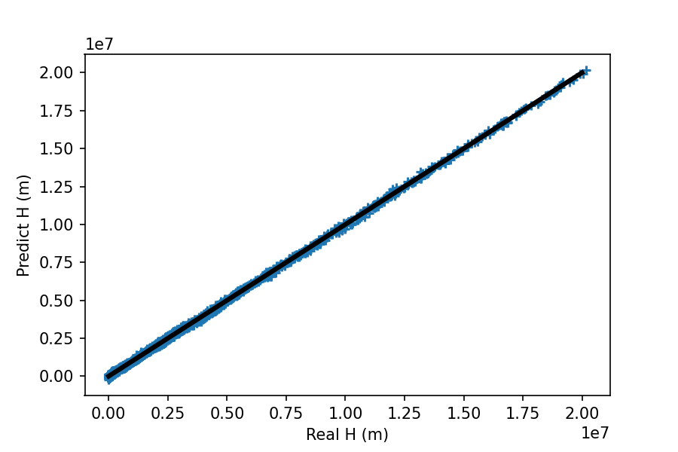
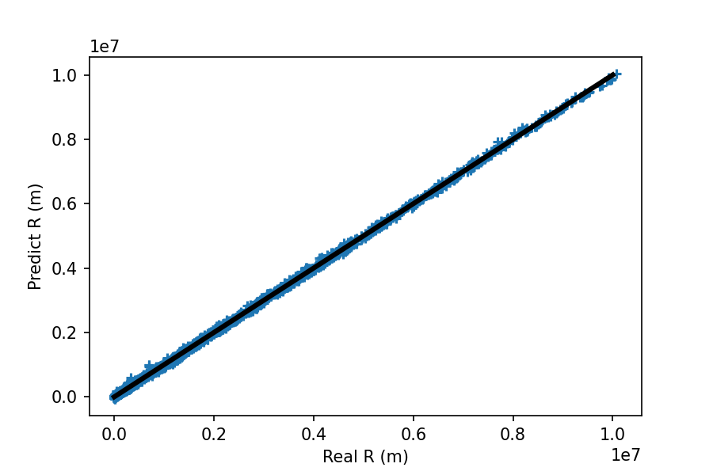
With Standardization vs Without Standardization
Without
Standardization
r = 0.90079
r = 0.91352
With
Standardization
r = 0.99982
r = 0.99976
Pearson correlation coefficient (r)

Slide 10
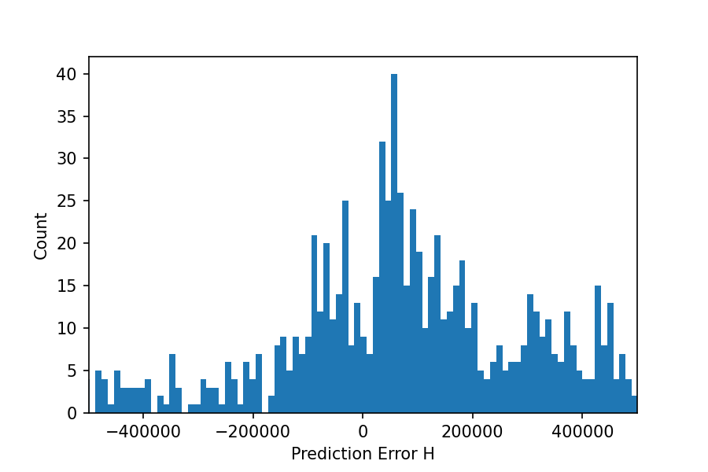
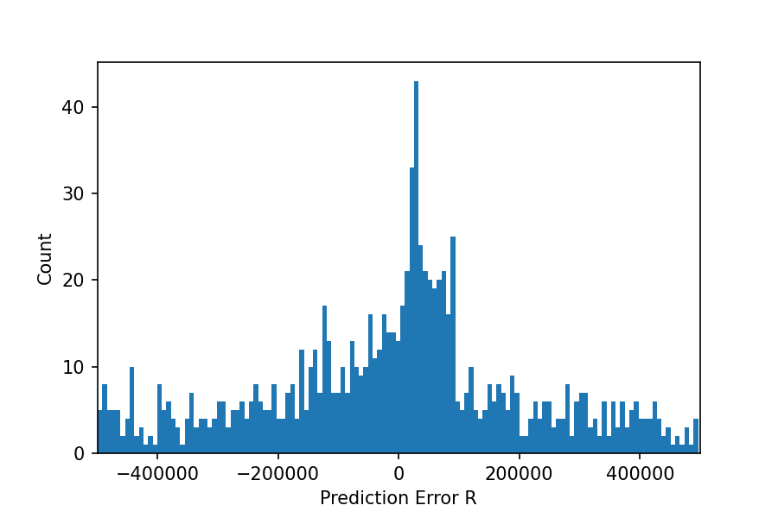
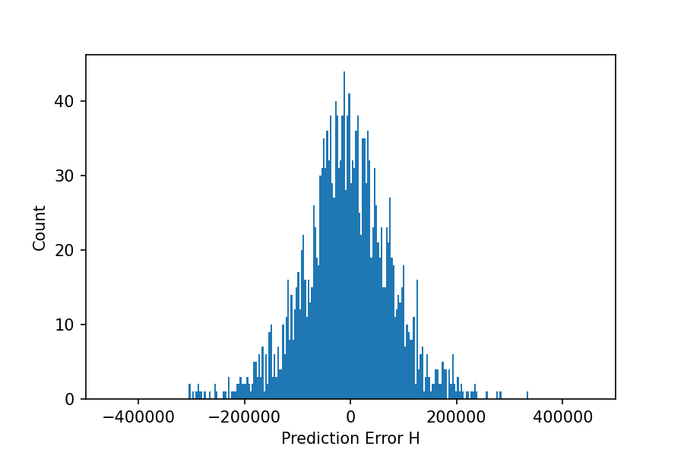
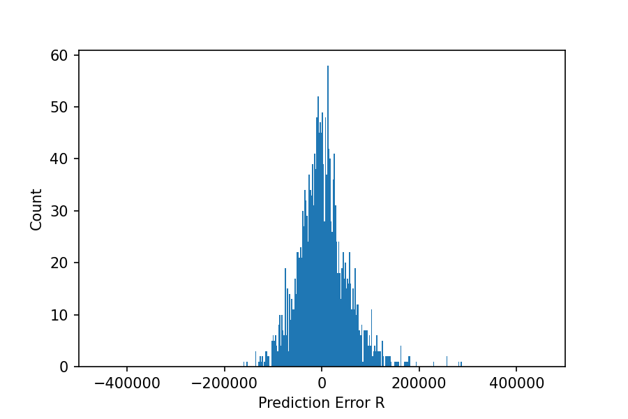
With Standardization vs Without Standardization
Error = Predict [value] - Real [value]
Without
Standardization
With
Standardization

Slide 11
ML Setting
Dense Network
Data | • 10000 Dataset (1 < V0 < 100 , 1° < θ < 89°) 80% ( Train ) 20% ( Test )
Model | • ANN • Hidden layers : 5 • Nodes : 10 / layer • Activation Functions : relu • Optimizer : adam • Epoch : 500 • Batch Size : 500
Evaluation | • MSE ( Mean Squared Error) • 5 - fold Cross-Validation
Broad Network
Data | • 10000 Dataset (1 < V0 < 100 , 1° < θ < 89°) 80% ( Train ) 20% ( Test )
Model | • ANN • Hidden layers : 2 • Nodes : 25 / layer • Activation Functions : relu • Optimizer : adam • Epoch : 500 • Batch Size : 500
Evaluation | • MSE ( Mean Squared Error) • 5 - fold Cross-Validation

Slide 12
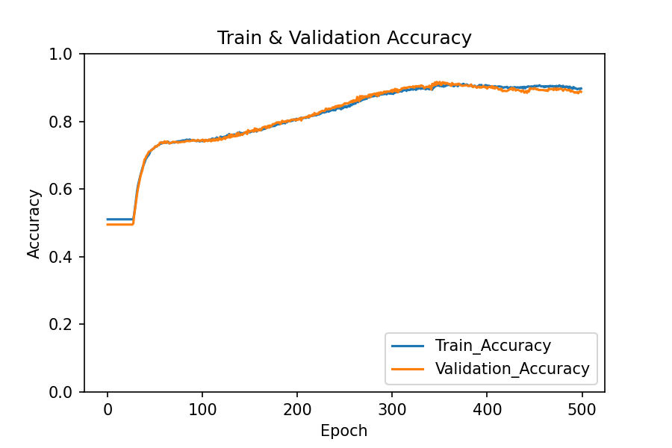
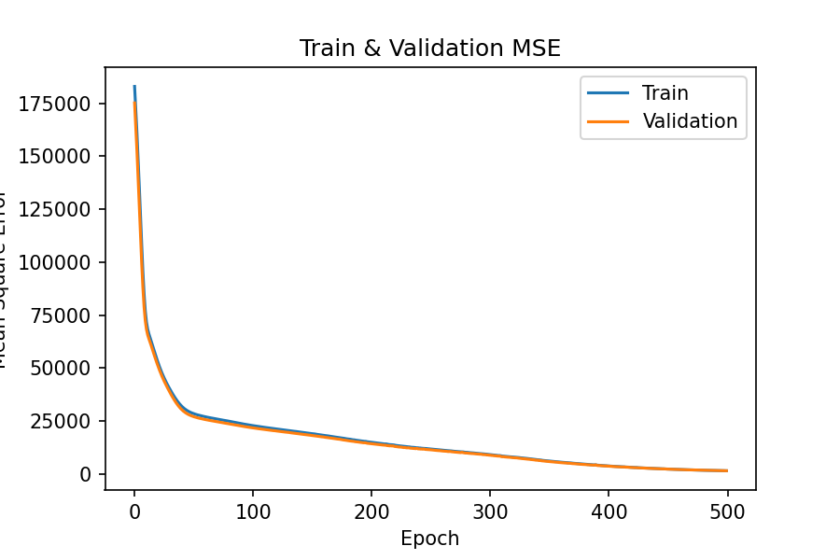
Broad Network vs Deep Network
Broad
Network
Accuracy : 89.35%
Loss : 1343.987
Deep
Network
Accuracy : 94.75%
Loss : 406.7997
Notes:
收斂速度

Slide 13
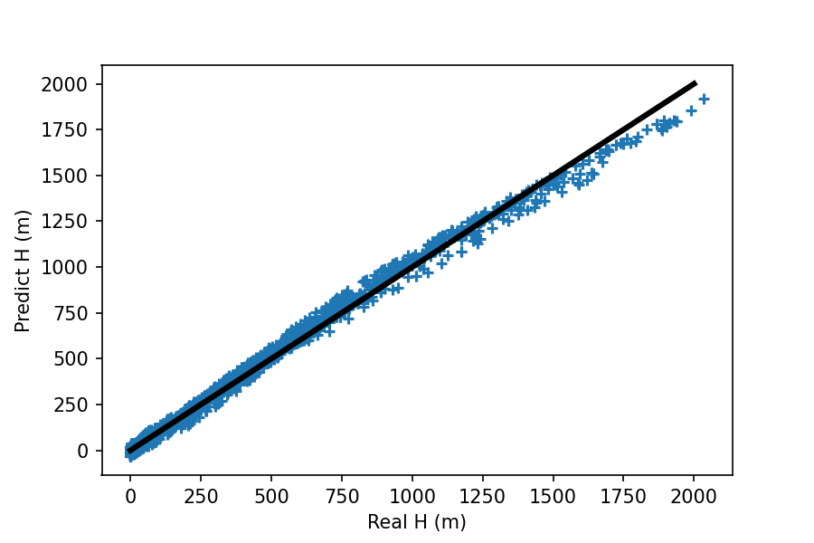
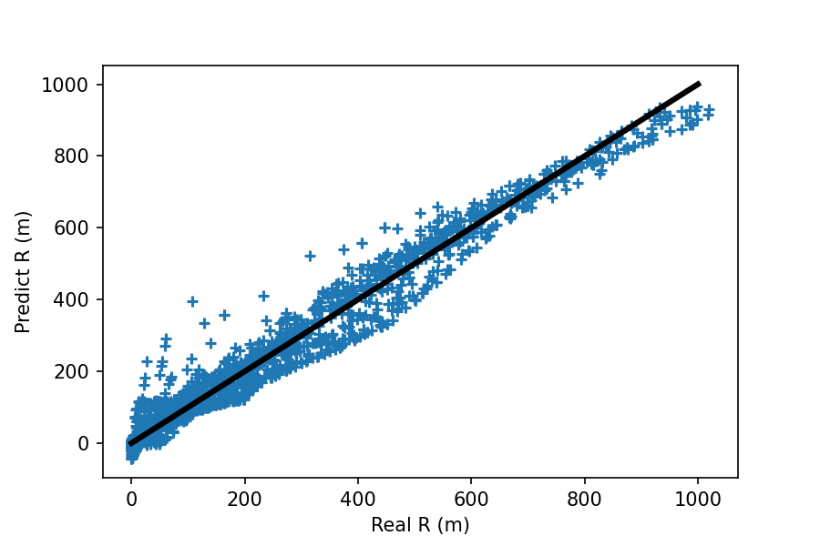
Broad Network vs Deep Network
Pearson correlation coefficient (r)
Broad
Network
r = 0.99746
r = 0.98576
Deep
Network
r = 0.99896
r = 0.99642
Pearson correlation coefficient (r)

Slide 14
ML Setting
Machine Learning Setting
Data | • 10000 Dataset 80% ( Train ) ➔ 1 < V0 < 100 , 1° < θ < 45° 20% ( Test ) ➔ 1 < V0 < 1000 , 1° < θ < 89°
Model | • ANN • Hidden layers : 5 • Nodes : 10 / layer • Activation Functions : relu • Optimizer : adam • Epoch : 500 • Batch Size : 500
Evaluation | • MSE ( Mean Squared Error) • 5 - fold Cross-Validation

Slide 15
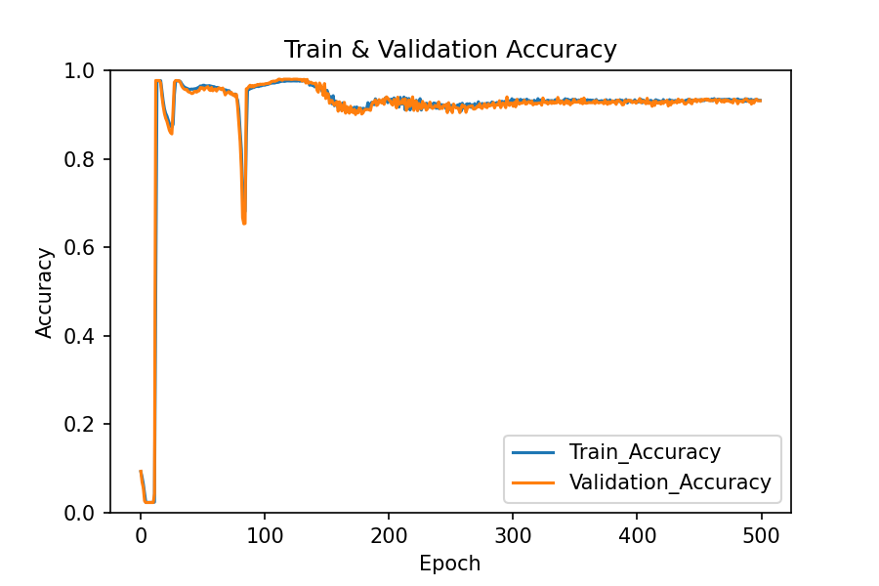
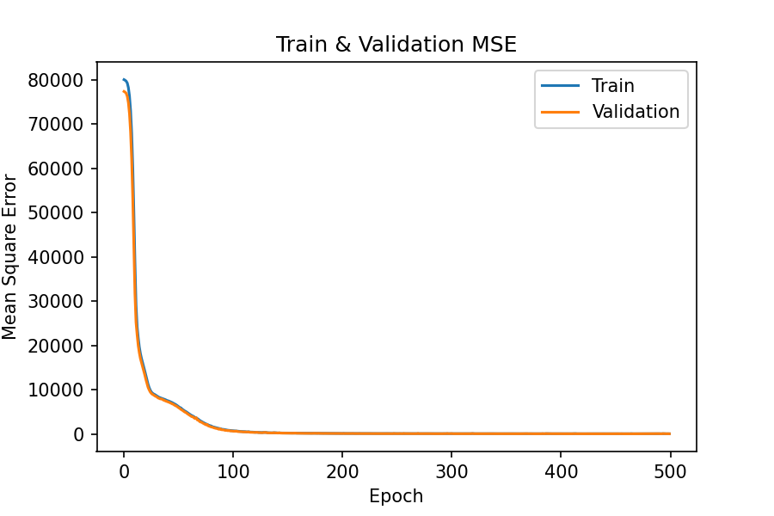
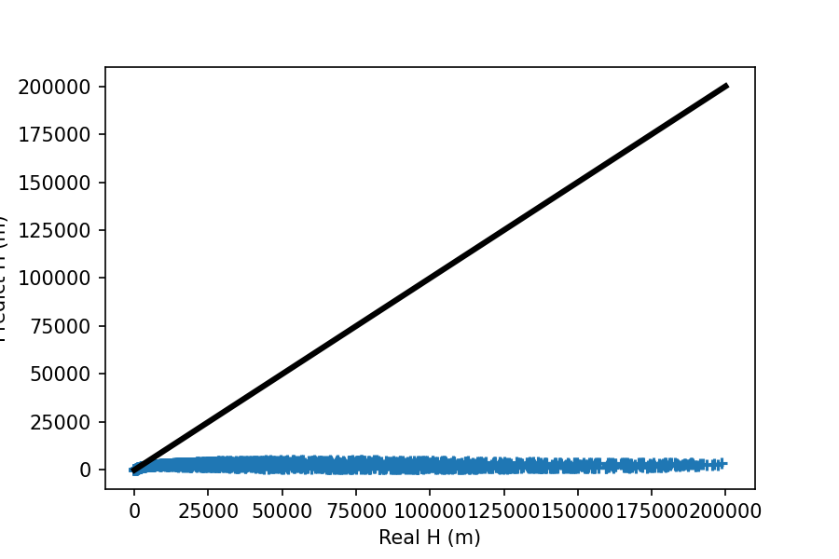
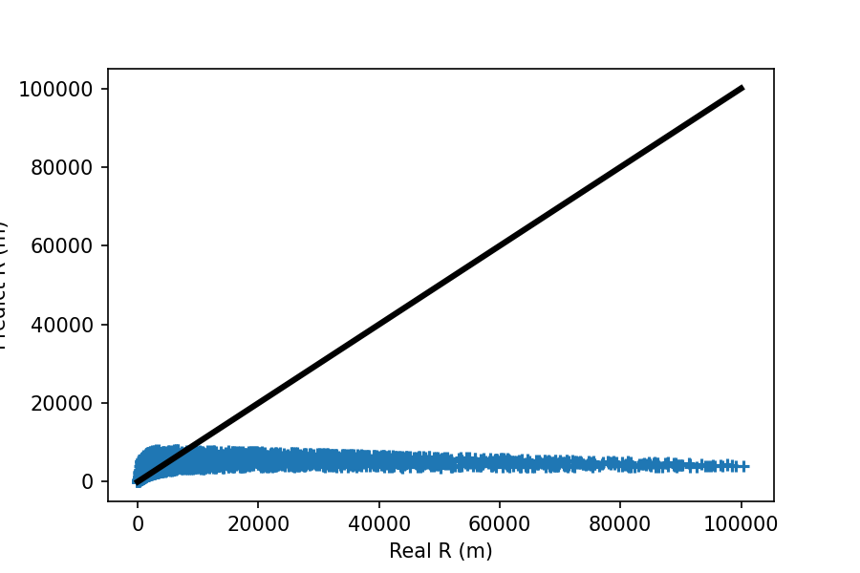
Accuracy : 11.60%
Loss : 464300
r = 0.10491
r = 0.32606
Pearson correlation coefficient (r)

Slide 16
ML Setting
Machine Learning Setting
Data | • 10000 Dataset 80% ( Train ) ➔ 1 < V0 < 100 ( Even ) , 1° < θ < 89° 20% ( Test ) ➔ 1 < V0 < 100 ( Odd ) , 1° < θ < 89°
Model | • ANN • Hidden layers : 5 • Nodes : 10 / layer • Activation Functions : relu • Optimizer : adam • Epoch : 500 • Batch Size : 500
Evaluation | • MSE ( Mean Squared Error) • 5 - fold Cross-Validation

Slide 17
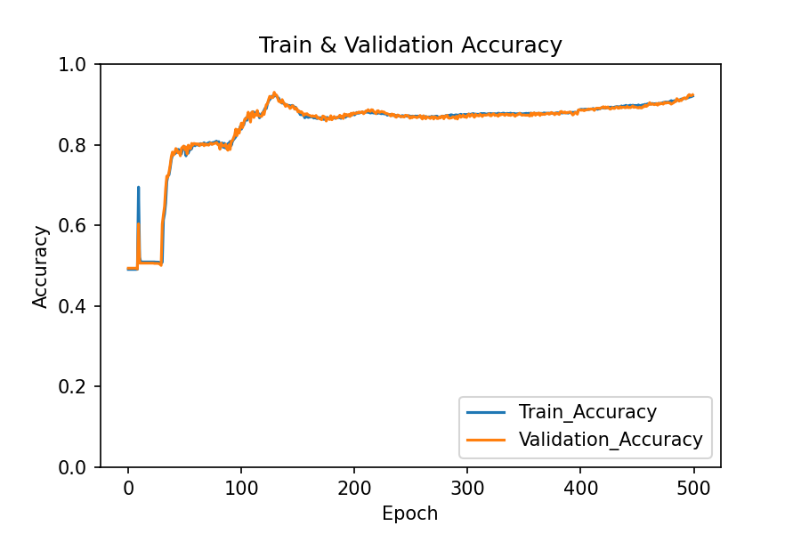
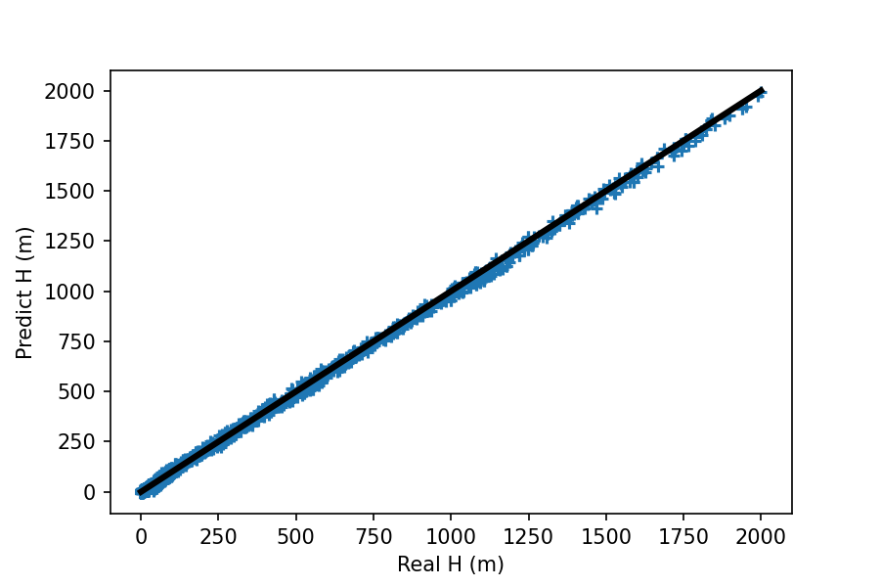
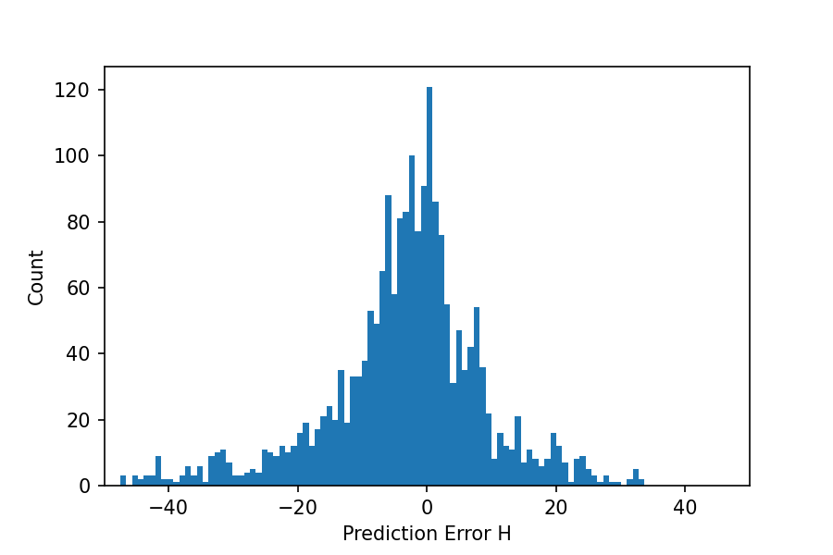
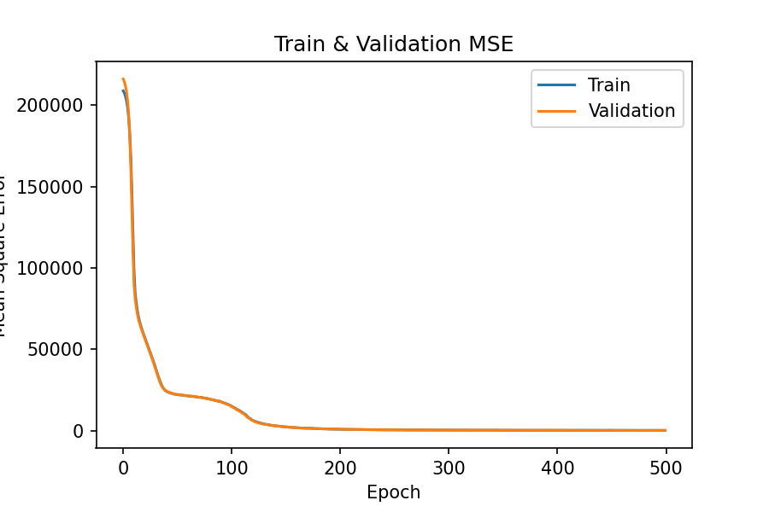
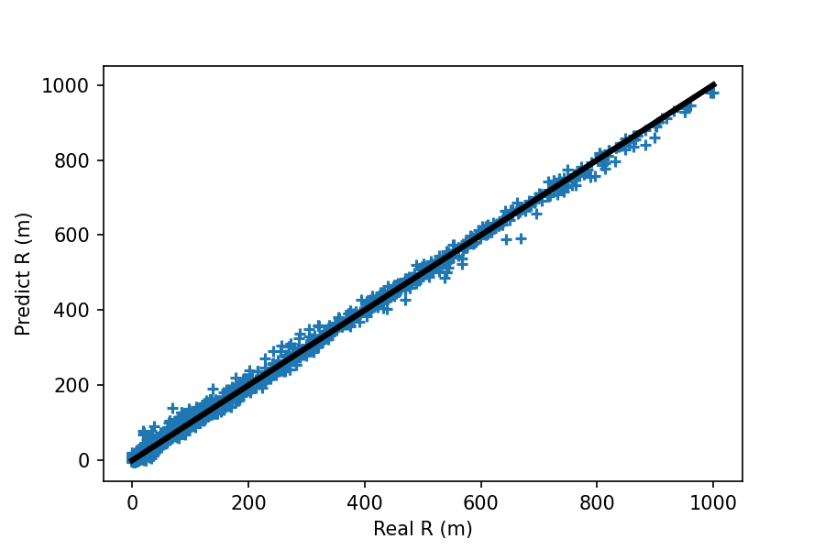
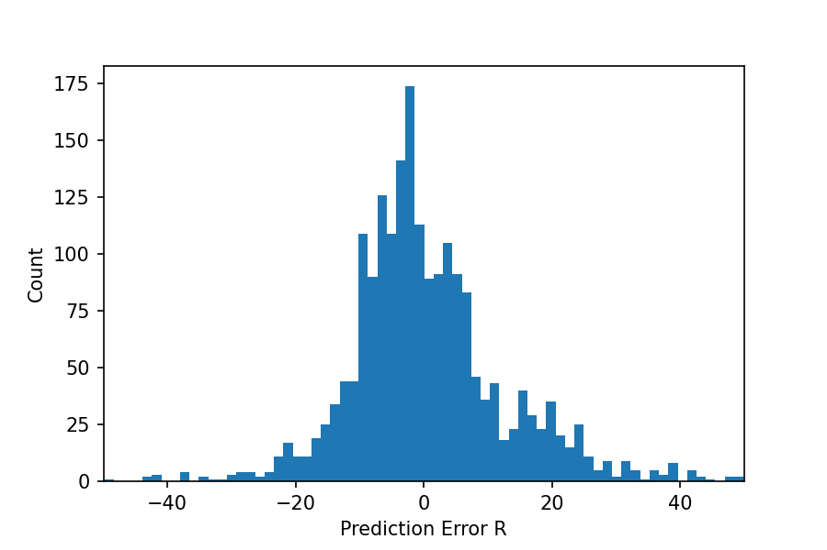
Even Training Set / Odd Testing Set
Accuracy : 91.35%
r = 0.99963
Loss : 168.719
r = 0.99850
Pearson correlation coefficient (r)

Slide 18
Conclusion
Dataset |  | Accuracy | MSE | r (H) | r (R)
1 < V0 < 100 1° < θ < 89° | Non - Standardization | 94.75% | 406.7997 | 0.99896 | 0.99642
 | Standardization | 98.75% | 0.000592 | 0.99981 | 0.99972
1 < V0 < 10000 1° < θ < 89° | Non - Standardization | 75.70% | 2.429e12 | 0.90079 | 0.91352
 | Standardization | 97.85% | 0.000406 | 0.99982 | 0.99976
1 < V0 < 100 1° < θ < 89° | Broad Network | 89.35% | 1343.987 | 0.99746 | 0.98576
 | Deep Network | 94.75% | 406.7997 | 0.99896 | 0.99642
Training Set | Testing Set | Accuracy | MSE | r (H) | r (R)
1 < V0 < 100 1° < θ < 45° | 1 < V0 < 1000 1° < θ < 89° | 11.60% | 464300 | 0.10491 | 0.32606
1 < V0 < 100 (Even) 1° < θ < 89° | 1 < V0 < 100 (Odd) 1° < θ < 89° | 91.35% | 168.719 | 0.99963 | 0.99850

Slide 19
Conclusion
Dataset |  | Accuracy | MSE | r (H) | r (R)
1 < V0 < 100 1° < θ < 89° | Non - Standardization | 94.75% | 406.7997 | 0.99896 | 0.99642
 | Standardization | 98.75% | 0.000592 | 0.99981 | 0.99972
1 < V0 < 10000 1° < θ < 89° | Non - Standardization | 75.70% | 2.429e12 | 0.90079 | 0.91352
 | Standardization | 97.85% | 0.000406 | 0.99982 | 0.99976
1 < V0 < 100 1° < θ < 89° | Broad Network | 89.35% | 1343.987 | 0.99746 | 0.98576
 | Deep Network | 94.75% | 406.7997 | 0.99896 | 0.99642
Training Set | Testing Set | Accuracy | MSE | r (H) | r (R)
1 < V0 < 100 1° < θ < 45° | 1 < V0 < 1000 1° < θ < 89° | 11.60% | 464300 | 0.10491 | 0.32606
1 < V0 < 100 (Even) 1° < θ < 89° | 1 < V0 < 100 (Odd) 1° < θ < 89° | 91.35% | 168.719 | 0.99963 | 0.99850

Slide 20
Conclusion
Dataset |  | Accuracy | MSE | r (H) | r (R)
1 < V0 < 100 1° < θ < 89° | Non - Standardization | 94.75% | 406.7997 | 0.99896 | 0.99642
 | Standardization | 98.75% | 0.000592 | 0.99981 | 0.99972
1 < V0 < 10000 1° < θ < 89° | Non - Standardization | 75.70% | 2.429e12 | 0.90079 | 0.91352
 | Standardization | 97.85% | 0.000406 | 0.99982 | 0.99976
1 < V0 < 100 1° < θ < 89° | Broad Network | 89.35% | 1343.987 | 0.99746 | 0.98576
 | Deep Network | 94.75% | 406.7997 | 0.99896 | 0.99642
Training Set | Testing Set | Accuracy | MSE | r (H) | r (R)
1 < V0 < 100 1° < θ < 45° | 1 < V0 < 1000 1° < θ < 89° | 11.60% | 464300 | 0.10491 | 0.32606
1 < V0 < 100 (Even) 1° < θ < 89° | 1 < V0 < 100 (Odd) 1° < θ < 89° | 91.35% | 168.719 | 0.99963 | 0.99850

Slide 21
Conclusion
Dataset |  | Accuracy | MSE | r (H) | r (R)
1 < V0 < 100 1° < θ < 89° | Non - Standardization | 94.75% | 406.7997 | 0.99896 | 0.99642
 | Standardization | 98.75% | 0.000592 | 0.99981 | 0.99972
1 < V0 < 10000 1° < θ < 89° | Non - Standardization | 75.70% | 2.429e12 | 0.90079 | 0.91352
 | Standardization | 97.85% | 0.000406 | 0.99982 | 0.99976
1 < V0 < 100 1° < θ < 89° | Broad Network | 89.35% | 1343.987 | 0.99746 | 0.98576
 | Deep Network | 94.75% | 406.7997 | 0.99896 | 0.99642
Training Set | Testing Set | Accuracy | MSE | r (H) | r (R)
1 < V0 < 100 1° < θ < 45° | 1 < V0 < 1000 1° < θ < 89° | 11.60% | 464300 | 0.10491 | 0.32606
1 < V0 < 100 (Even) 1° < θ < 89° | 1 < V0 < 100 (Odd) 1° < θ < 89° | 91.35% | 168.719 | 0.99963 | 0.99850

Slide 22
Conclusion
Dataset |  | Accuracy | MSE | r (H) | r (R)
1 < V0 < 100 1° < θ < 89° | Non - Standardization | 94.75% | 406.7997 | 0.99896 | 0.99642
 | Standardization | 98.75% | 0.000592 | 0.99981 | 0.99972
1 < V0 < 10000 1° < θ < 89° | Non - Standardization | 75.70% | 2.429e12 | 0.90079 | 0.91352
 | Standardization | 97.85% | 0.000406 | 0.99982 | 0.99976
1 < V0 < 100 1° < θ < 89° | Broad Network | 89.35% | 1343.987 | 0.99746 | 0.98576
 | Deep Network | 94.75% | 406.7997 | 0.99896 | 0.99642
Training Set | Testing Set | Accuracy | MSE | r (H) | r (R)
1 < V0 < 100 1° < θ < 45° | 1 < V0 < 1000 1° < θ < 89° | 11.60% | 464300 | 0.10491 | 0.32606
1 < V0 < 100 (Even) 1° < θ < 89° | 1 < V0 < 100 (Odd) 1° < θ < 89° | 91.35% | 168.719 | 0.99963 | 0.99850

